Slide 1

RISK ANALYSIS
Tableau mini-Project Ayiti Analytics/ Bootcamp 2021
Analyze on Credit Risk
Analyse
Prepared by: Wedsanley Jean PHILIPPE

Slide 2
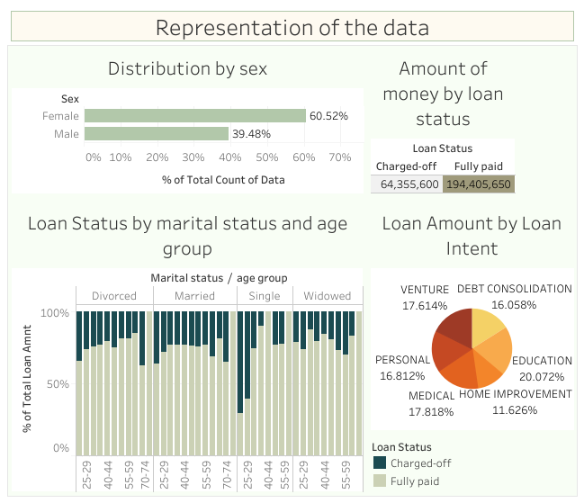

Slide 3
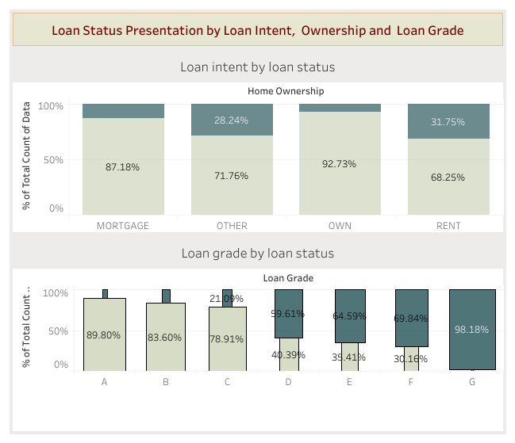

Slide 4
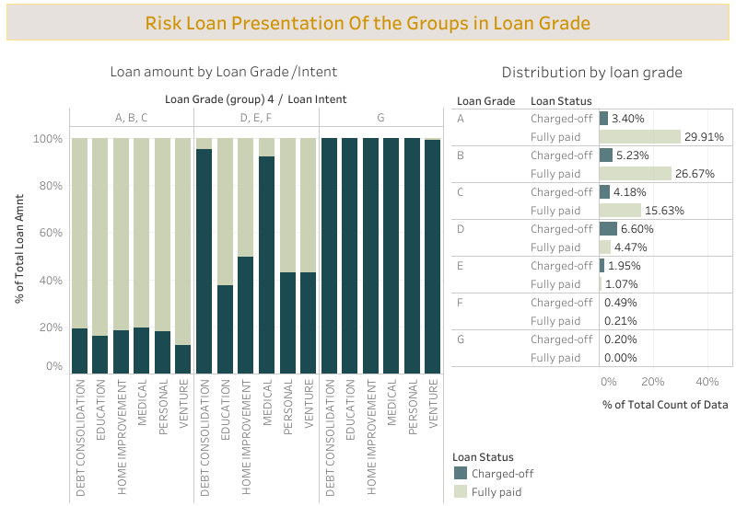

Slide 5
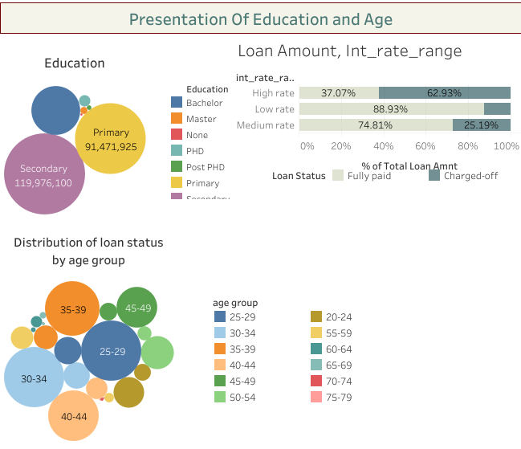

Slide 6
The company lent a total of 258,761,250 US dollars to 27,154 people, 60.52% of whom are women. It lost 64,355,650 US dollars, which represents 22.04% of the total amount loaned. More than 20% of the loans are taken for education and many of them are repaid except for the most at risk (Group G) who cannot repay whatever the reason they borrowed or their age. A first solution would be to stop lending to people in Group G, 98.18% of them are written off.Translated with www.DeepL.com/Translator (free version)
For groups D, E, F; the rate of write-offs is around 90% when the intention behind the loan is Debt Consolidation or medical reason.
More than 50% of the people who are celibate and aged 20-29 are radiated, we should become more reticent towards these people.
62.93% of the people who have an interest rate that is higher than 15% are written off at the end, we can understand the effect of the risk associated with it but the results show that we borrow from too many risky people.
People who own their own home are more likely to pay it back, but the data shows that over 37% of people who rent a home are broke, so they need to borrow less.

